Slide 1
Module 11

Slide 2

Co-ordination in human beings is controlled by two mechanisms
Nervous control
Chemical control
Let us first see what is Nervous control ?

Slide 3
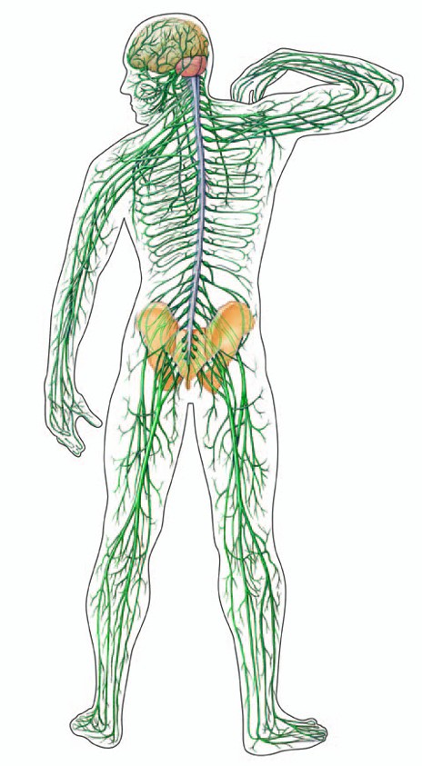
Human nervous system consists of
Brain
Spinal cord
Nerves

Slide 4
Nervous System
Nervous system is a system that controls all of the activities of the body.
The nervous system can be divided into three parts :
1. Central nervous system (CNS)
2. Peripheral nervous system (PNS)
3. Autonomic nervous system (ANS)

Slide 5
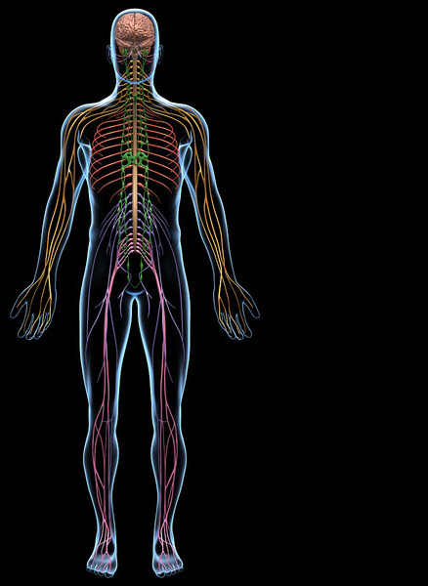
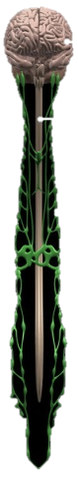
Central nervous system consists of
It regulates all activities of body.
Brain and spinal cord
Control

Slide 6
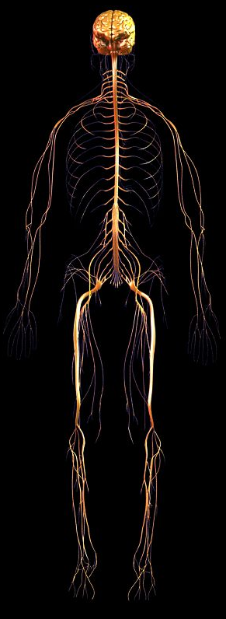
Peripheral Nervous system consists of
It is a network of nerves spread through out the body
connecting all parts of the body to the central nervous system.
All the nerves present in the periphery of the body

Slide 7
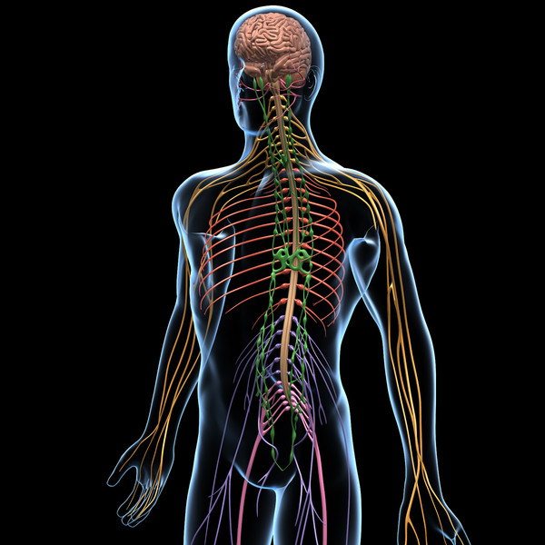
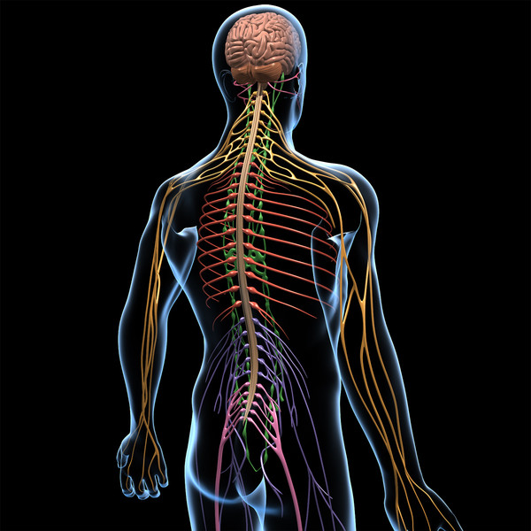
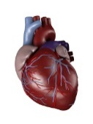
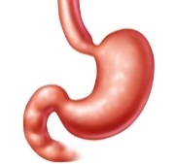
Autonomic nervous system consists of
Nerves which are present in the involuntary organs like heart, stomach, lungs etc.
Autonomic nerves

Slide 8
Thank You

